Slide 1
Threat Prioritization Overview
AVCDL-Foundation-9.1
Charles Wilson
Staff Product Cybersecurity Architect
version 3
2026-07-20
Notes:
Script:
I'm Charles Wilson, staff product cybersecurity architect at Torc Robotics.
This presentation will cover an overview of the Threat Prioritization process.

Slide 2
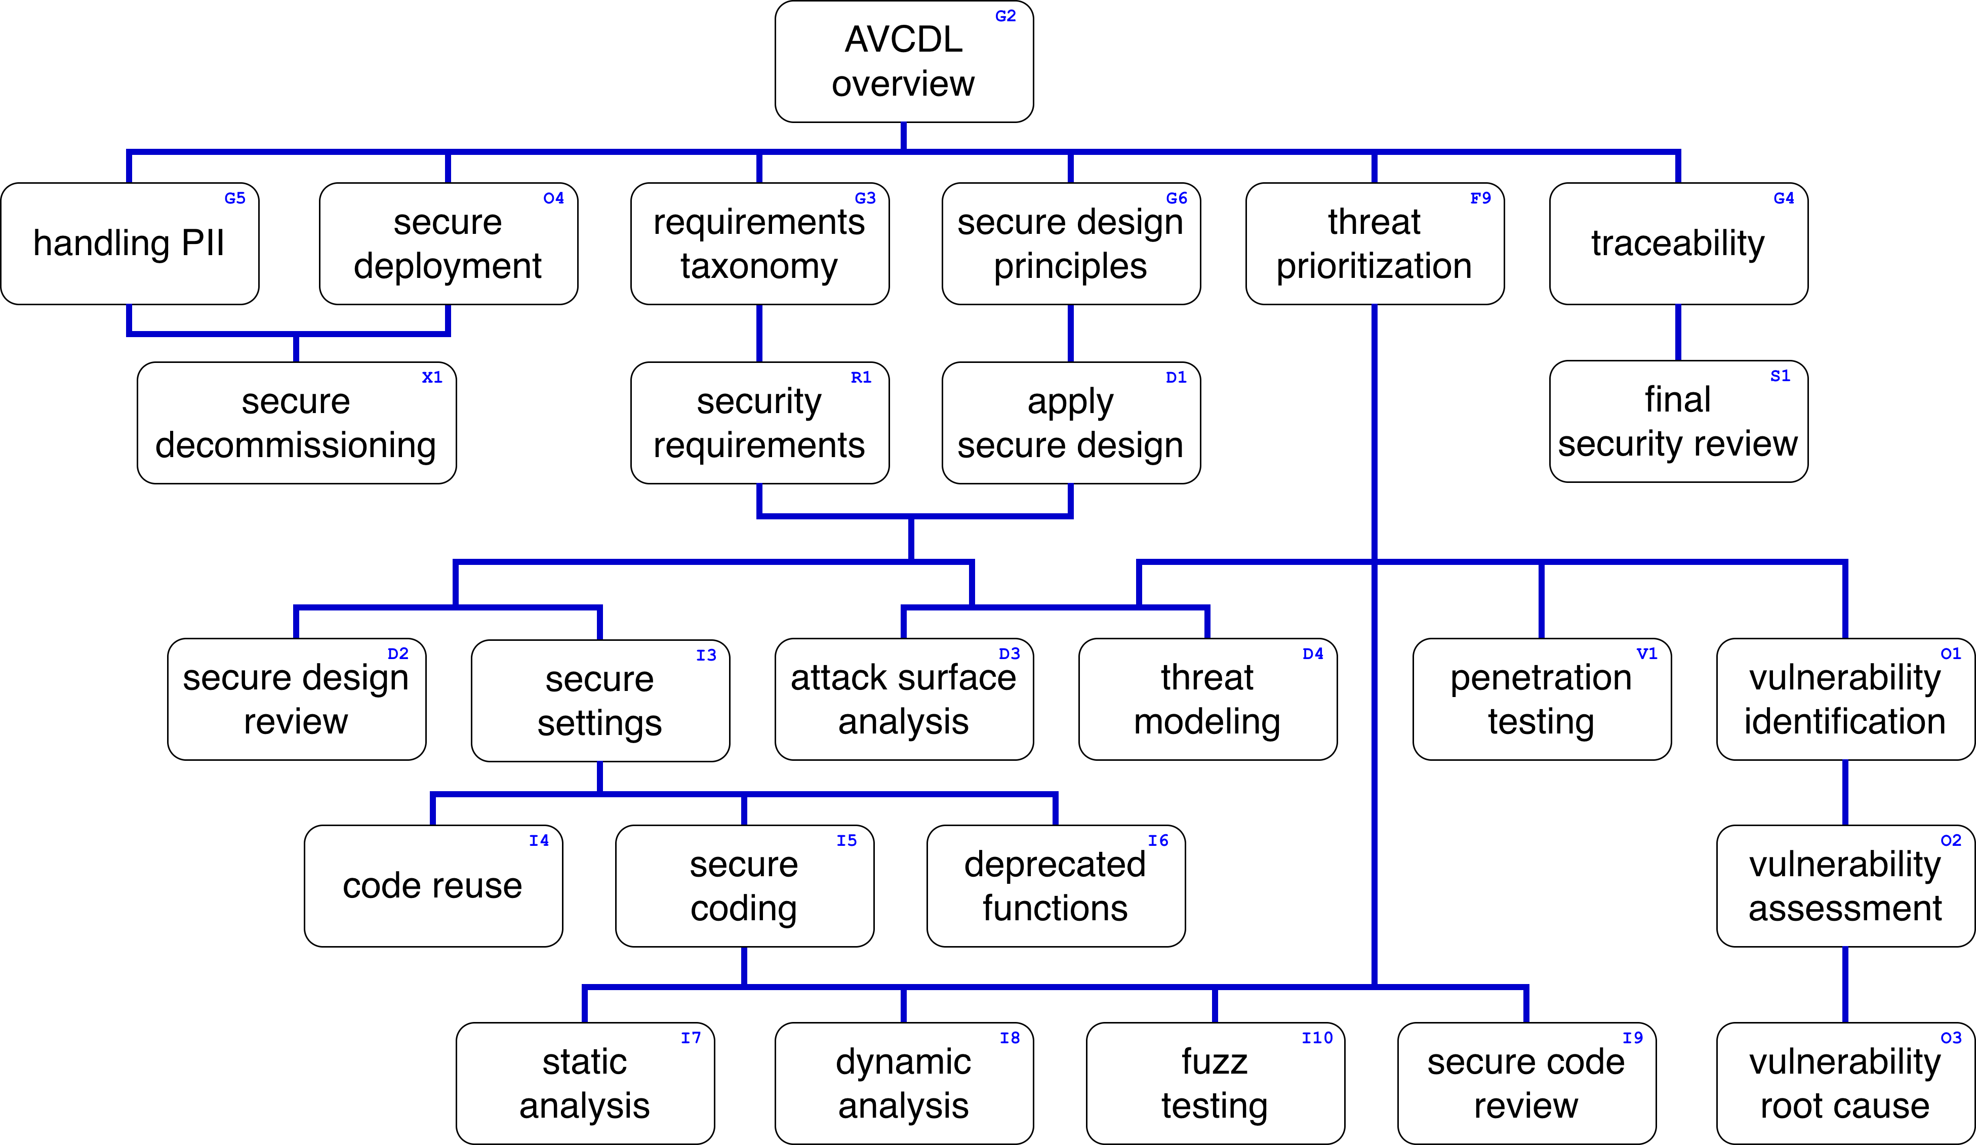
Training Path
Notes:
Script:
This diagram shows the overall AVCDL training path.
If you’re taking this training, it’s assumed that you’ve already completed the AVCDL overview training.
This training covers an overview of threat prioritization.

Slide 3

Introduction*
* Musician in London performs on electric guitar and a small drum kit (link in references)
Notes:
Script:
When we think about how cybersecurity is done in the context of product development, it tends to be in the same way that we think about a one man band.
They're responsible for bringing their own instruments, playing the music, and dealing with everything else related to the activity.
The classic example of this is penetration testing.
You can penetration test anything.
You don't need input from anyone else.
You just need the system to be evaluated.
When you’re done, you produce a report.
Now consider
[pause]
threat modeling.
In threat modeling, you look at the system, conduct an analysis, and again produce a report.
A report which typically looks nothing like the report that we get from penetration testing.
[pause]
And fuzz testing is another version of this same story.
[pause]
In our example here with our three one-man bands, if we were to have them play simultaneously, the result would probably not be pleasing to the ear.
What we want is more like
[break]
a symphony orchestra, where the products of each of the performers comes together into something greater than the sum of its parts.
That's the point of having a threat prioritization process applied uniformly across multiple activities.
We want a methodology that produces consistent outputs, not requiring special handling for every cybersecurity activity.

Slide 4
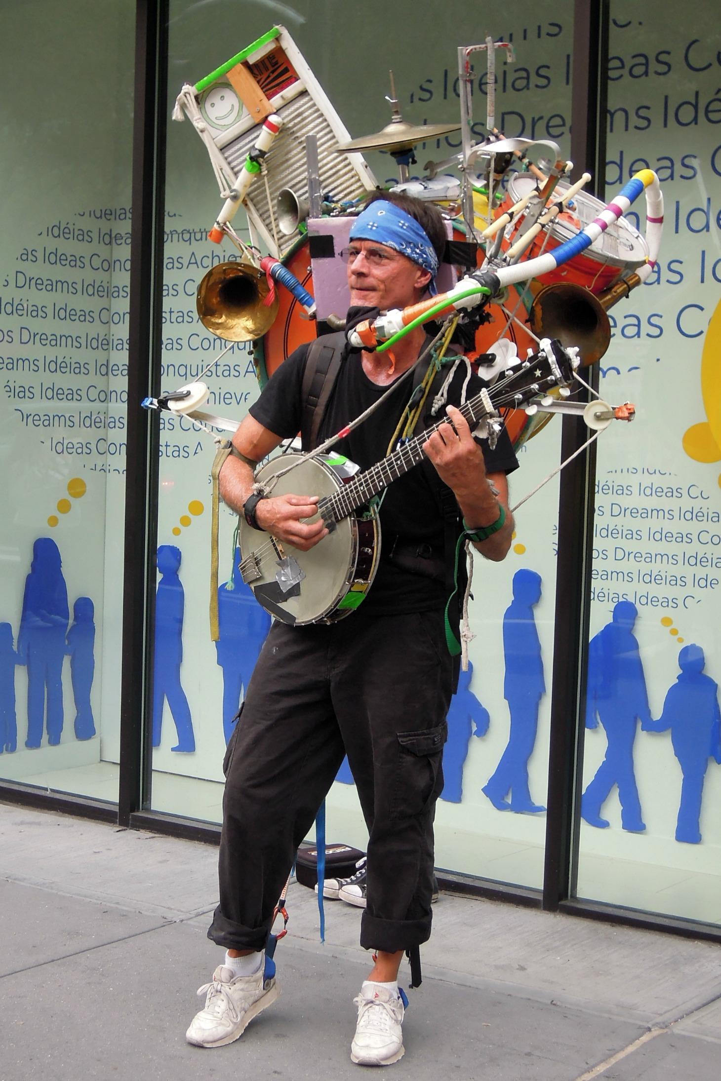
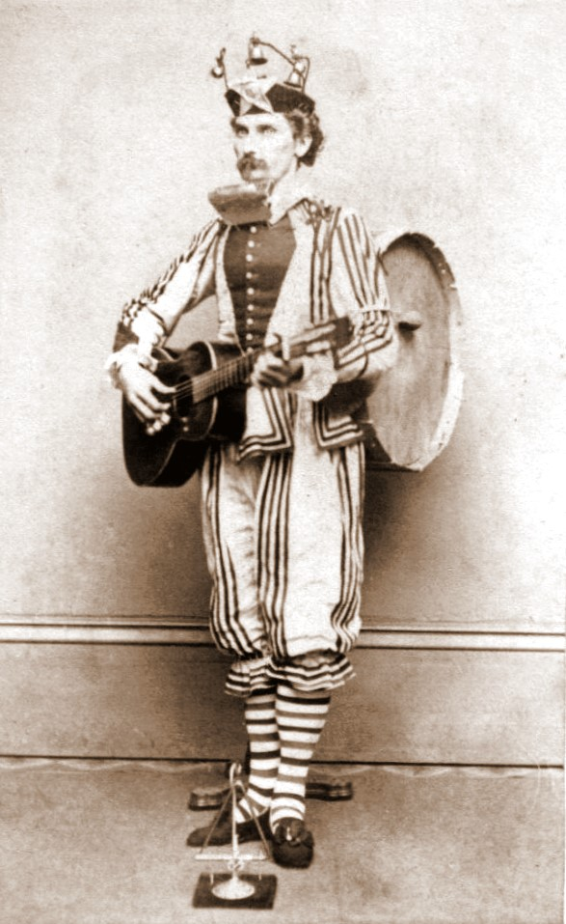
Introduction – Overlay
* Jeff Masin, a one-man band in New York City (link in references)
* One man band 1865 (link in references)
Notes:
overlay

Slide 5
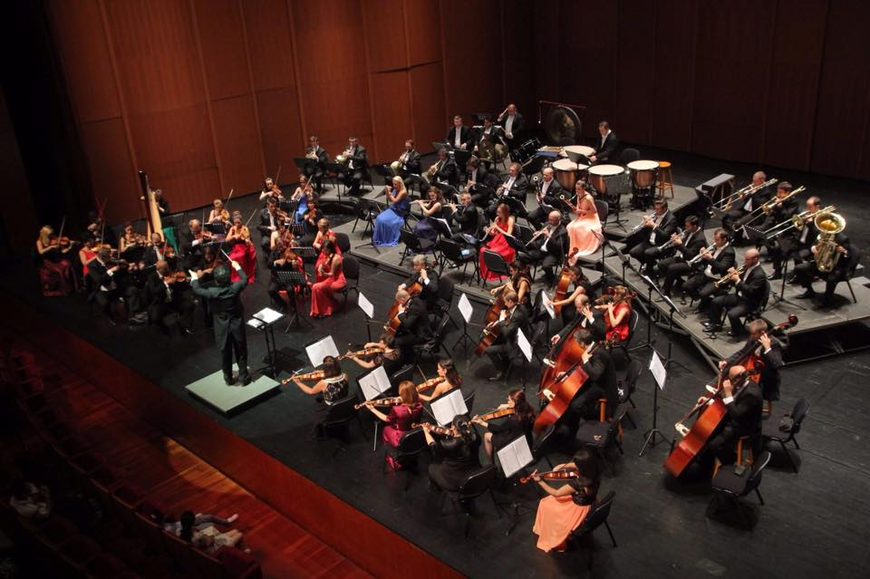
Introduction*
* Orchestra Simfonica București (link in references)
Notes:
Script:
When we think about how cybersecurity is done in the context of product development, it tends to be in the same way that we think about a one man band.
They're responsible for bringing their own instruments, playing the music, and dealing with everything else related to the activity.
The classic example of this is penetration testing.
You can penetration test anything.
You don't need input from anyone else.
You just need the system to be evaluated.
When you’re done, you produce a report.
Now consider
[pause]
threat modeling.
In threat modeling, you look at the system, conduct an analysis, and again produce a report.
A report which typically looks nothing like the report that we get from penetration testing.
[pause]
And fuzz testing is another version of this same story.
[pause]
In our example here with our three one-man bands, if we were to have them play simultaneously, the result would probably not be pleasing to the ear.
What we want is more like
[break]
a symphony orchestra, where the products of each of the performers comes together into something greater than the sum of its parts.
That's the point of having a threat prioritization process applied uniformly across multiple activities.
We want a methodology that produces consistent outputs, not requiring special handling for every cybersecurity activity.

Slide 6
Threat Candidate Sources
Notes:
Script:
It’s very useful to have a process that can handle the prioritization of threats coming from multiple sources, so let's take a moment to consider what those sources are.

Slide 7
Sources
Attack Surface Analysis
Threat Modeling
Deprecated Functions
Static Analysis
Dynamic Analysis
Fuzz Testing
Penetration Testing
Incident Response
Notes:
Script:
For simplicity sake, we'll address the threat sources in AVCDL lifecycle sequence.
First we have
[pause]
attack surface analysis.
It might not seem obvious that we'd include the attack surface analysis in this list, but not every issue identified in the attack surface analysis can go directly into the issue tracking system without review.
At the other end of the spectrum, we have
[pause]
threat modeling.
The expectation is that threat modeling generates threat candidates which need further review, as the issues that come out of the activity need to be reviewed in a system context, which is what the threat prioritization process does.
Next is
[pause]
deprecated functions.
Not all deprecated functions currently in use are going to need to be replaced in order to ensure the level of cybersecurity that we'd like to have.
So, we need to put them through this process.
[pause]
More obvious sources are
[pause]
static analysis
[pause]
dynamic analysis
[pause]
fuzz testing, and
[pause]
penetration testing.
Keep in mind with this one, just because you can break it doesn't necessarily mean that it needs to be fixed.
We need to consider these issues in the greater system context.
Finally, we have
[pause]
incident response.
As with attack surface analysis, incident response doesn't come immediately to mind.
However, with incident response, once we've replicated the problem, we have a threat that we need to determine how it impacts the system.
As with penetration testing, just because it’s a valid issue, doesn't mean that it needs to be addressed.
We need to take issues and give them context, and that's part of the process that we go through in the threat prioritization process.
The only exception is that in incident response where the threat prioritization process takes place in the middle of the incident response process.
Refer to the incident response material for additional detail on this.

Slide 8
Workflow
Notes:
Script:
Let’s now look at the threat prioritization process workflow itself.

Slide 9
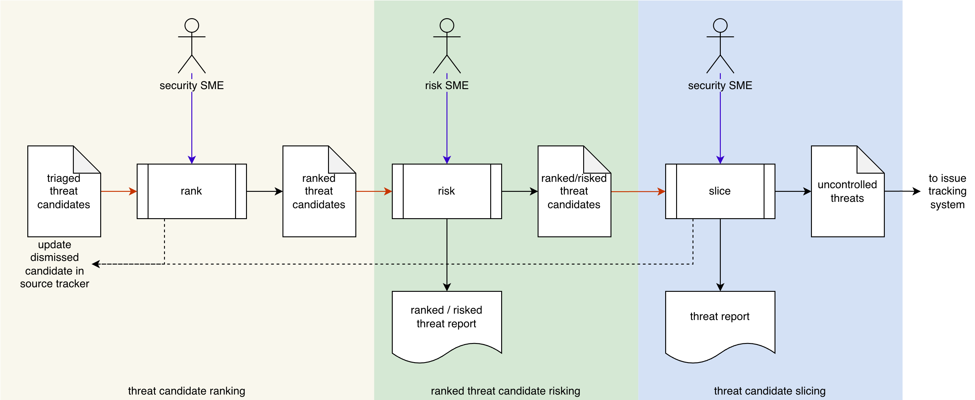
Threat Prioritization Workflow
Notes:
Script:
Here we have the main part of the threat prioritization process workflow.
It's comprised of three activities.
These are
• threat candidate ranking
• ranked threat candidate risking
and finally
• threat candidate slicing

Slide 10
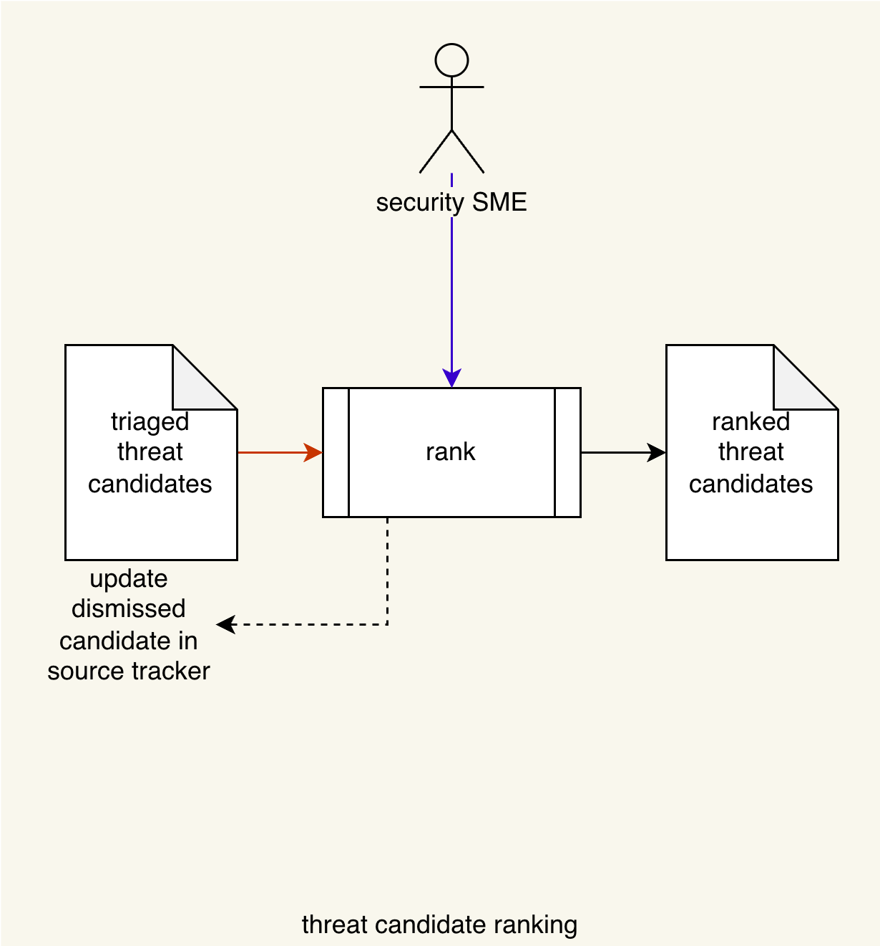
Threat Prioritization Workflow
Notes:
Script:
Here we have the main part of the threat prioritization process workflow.
It's comprised of three activities.
These are
• threat candidate ranking
• ranked threat candidate risking
and finally
• threat candidate slicing

Slide 11
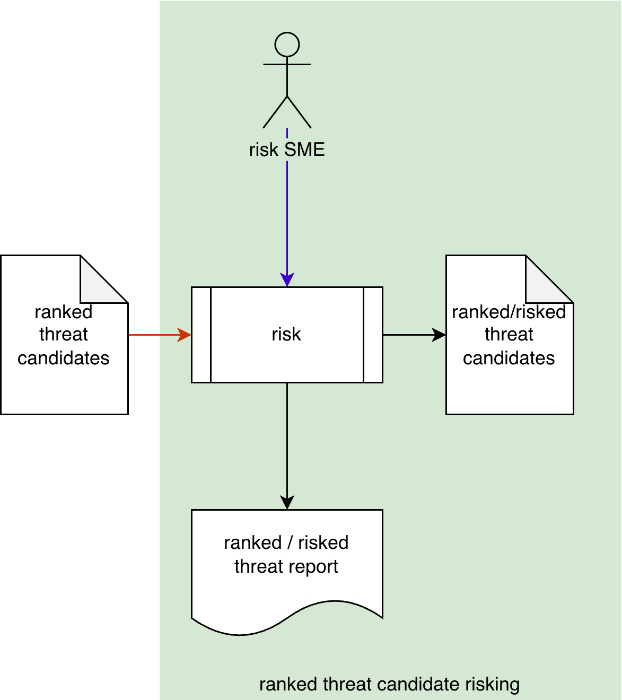
Threat Prioritization Workflow
Notes:
Script:
Here we have the main part of the threat prioritization process workflow.
It's comprised of three activities.
These are
• threat candidate ranking
• ranked threat candidate risking
and finally
• threat candidate slicing

Slide 12
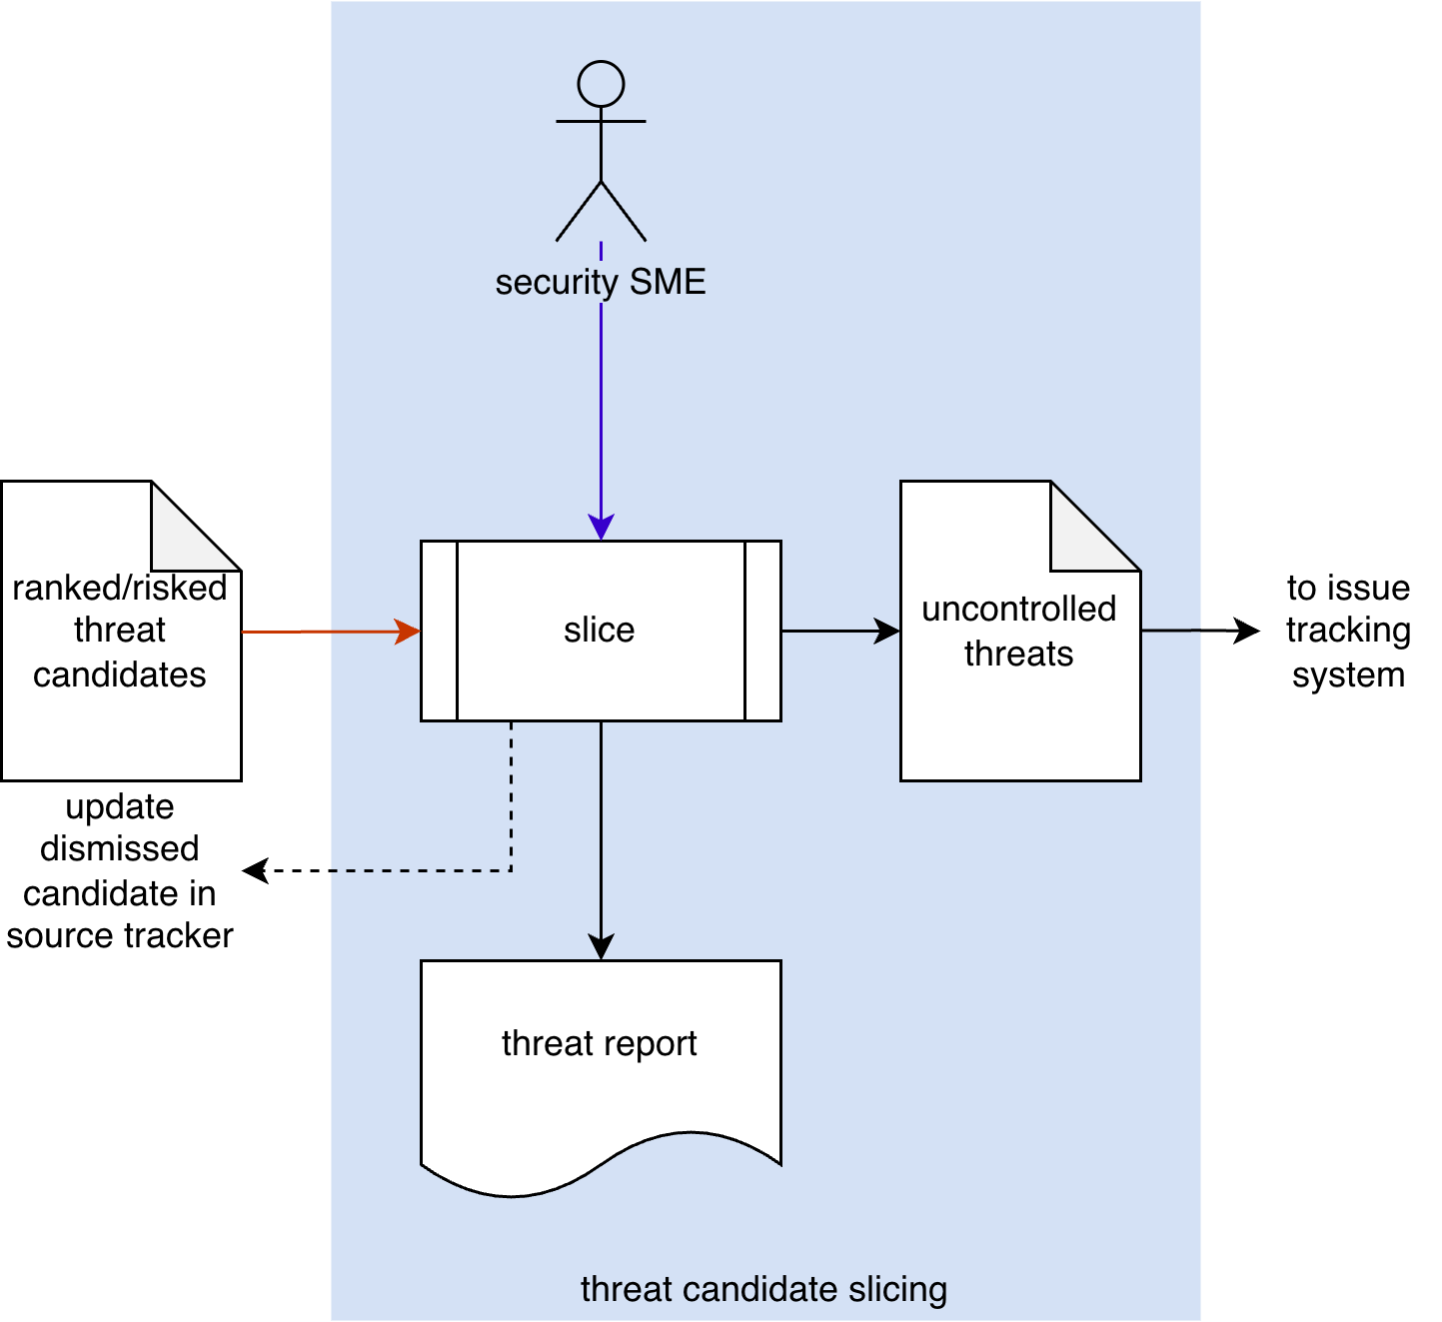
Threat Prioritization Workflow
Notes:
Script:
Here we have the main part of the threat prioritization process workflow.
It's comprised of three activities.
These are
• threat candidate ranking
• ranked threat candidate risking
and finally
• threat candidate slicing

Slide 13
Activities
Notes:
Script:
Let's now turn our attention to each of the activities that go into the threat prioritization process.

Slide 14
Threat Candidate Ranking
Worst case focus
Use a standard rubric
Notes:
Script:
Our first activity is that of threat candidate ranking.
The goal of this activity is to establish the likelihood of each of the threat candidates.
[pause]
The security SME takes
[pause]
the triage threat candidates.
[pause]
And conducts a ranking on them, producing
[pause]
a list of ranked threat candidates.
[pause]
Any candidates which are determined to be invalid are dismissed, and their source tracker is updated accordingly.
[pause]
A few things to consider here
[pause]
we want to focus on the worst case outcome if the threat is realized.
Second, when performing this activity
[pause]
We seek to use a standard rubric so that we have consistency and reproducibility.

Slide 15
Notes:
Script:
Probably the most well-known likelihood ranking system is CVSS.
CVSS is a system which has a score ranging from 0.0 to 10.0 in increments of 0.1.
It's a system based on the ordering of one hundred unique threats into a particular order, but we can quantize it into twelve buckets, as shown here.
CVSS also specifies a rating which quantized to only five levels of interest.
Technically four, but a true zero or none is added so that we can actually talk about a zero.
Those being none, low, medium, high, and critical.
These values map directly to the requirement of ISO/SAE 21434 which has very low, low, medium, and high.

Slide 16
Threat Candidate Risking
System-level focus
Use a standard rubric
Notes:
Script:
Our second activity is that of threat candidate risking.
The goal of this activity is to establish the impact of each of the threat candidates.
[pause]
the risk SME takes
[pause]
the ranked threat candidates and
[pause]
applies a risk rubric to them.
This yields
[pause]
a list of ranked risked threat candidates.
[pause]
And a ranked risked threat report is generated.
[pause]
Here the focus is at the system level, because it’s at this level that risk determination can be made.
Specifically, the risk SME is looking at how the threat candidates impact the system based on the worst case projection provided in the ranked threat candidates.
[pause]
As with the candidate ranking activity, we want to, where possible,
[pause]
use a standard rubric for the determination of the impact that the threat candidate has.

Slide 17
Notes:
Script:
For quantization in the impact space, let's take a look at the safety domain.
There’s ISO 26262, which is the safety standard for automotive.
We also have ISO 14971, the safety standard for medical devices.
ISO/SAE 21434, which specifies a numeric quantization standard for use with automotive cybersecurity.
And finally, FIPS 199, which is the IT standard addressing risk.
<pause>
You'll note that these don't line up perfectly as you can see 26262 has a three-value raking system.
As with the likelihood quantization, a zero or no impact value has been added in order to have a true zero.
<pause>
In order to go from the ISO 26262 space to the ISO/SAE 21434 space, you actually require more resolution than the 26262 numeric value provides.
<pause>
What we have in the impact space is far less granular, when compared with what we see in the likelihood space.
This is vastly different from the continuous space presented earlier.
<pause>
I’ve made the point of adding a true zero value twice now.
Does it really make that much of a difference?
Yes and no.
If we only consider true positive cases where the threat candidate has both a non-zero likelihood and impact, then we would never need a true zero. Mostly.
If we never use the values for anything other than in a text field in a report, then we wouldn’t need a true zero. Mostly.
But, if we need to store the value in a database or perform computations using numeric values or need to assign a value of zero likelihood or no impact, then we absolutely need a true zero.

Slide 18
Threat Candidate Slicing
Use an approved risk appetite
Don’t game the results
Notes:
Script:
Our second activity is that of threat candidate risking.
The goal of this activity is to establish the impact of each of the threat candidates.
[pause]
the risk SME takes
[pause]
the ranked threat candidates and
[pause]
applies a risk rubric to them.
This yields
[pause]
a list of ranked risked threat candidates.
[pause]
And a ranked risked threat report is generated.
[pause]
Here the focus is at the system level, because it’s at this level that risk determination can be made.
Specifically, the risk SME is looking at how the threat candidates impact the system based on the worst case projection provided in the ranked threat candidates.
[pause]
As with the candidate ranking activity, we want to, where possible,
[pause]
use a standard rubric for the determination of the impact that the threat candidate has.

Slide 19
Notes:
Script:
Now let's take a moment and look at how we're going to actually do the slicing operation itself.
<pause>
Here's a diagram that shows the way that the slicing or determination of controlled and uncontrolled threats is achieved.
The diagram is adapted from the FDA’s Post-market Management of Cybersecurity and Medical Devices document.
We have the values from the ranking and the risking activities, the likelihood and impact values.
We're showing them here as being continuous.
Similarly, the range from controlled to uncontrolled is also being shown as continuous.
The line bisecting the exploitability-severity space, shown here in red, is the risk appetite.
We need it not only to establish those threats we consider controlled or uncontrolled, but also to prioritize them.
Above the line, the threats are deemed to be uncontrolled, that is, in need of mitigation.
We will cover the mechanism used to make the determination of controlled versus uncontrolled and risk appetite in a bit.

Slide 20
Notes:
Script:
Now let's take a moment and look at how we're going to actually do the slicing operation itself.
<pause>
Here's a diagram that shows the way that the slicing or determination of controlled and uncontrolled threats is achieved.
The diagram is adapted from the FDA’s Post-market Management of Cybersecurity and Medical Devices document.
We have the values from the ranking and the risking activities, the likelihood and impact values.
We're showing them here as being continuous.
Similarly, the range from controlled to uncontrolled is also being shown as continuous.
The line bisecting the exploitability-severity space, shown here in red, is the risk appetite.
We need it not only to establish those threats we consider controlled or uncontrolled, but also to prioritize them.
Above the line, the threats are deemed to be uncontrolled, that is, in need of mitigation.
We will cover the mechanism used to make the determination of controlled versus uncontrolled and risk appetite in a bit.

Slide 21
Multiple Risk Domains
Notes:
Script:
Typically, when we talk about risk in the context of safety-critical, cyber-physical systems, we're talking about safety risk, but in reality, there are multiple risk domains that we need to consider.

Slide 22

Risk Domains
Notes:
Script:
The first and most obvious risk domain is
[pause]
that of safety.
This is unsurprising given that we're dealing with safety-critical, cyber-physical systems.
Second is
[pause]
finance, where issues impact individuals or the system’s manufacturer.
Third, we have
[pause]
operational risk, where we may have interference in the operation of the system itself.
Note that this domain deals with impacts which are not safety related.
Finally, we have
[pause]
privacy.
This may be either related to the identification and tracking of the system itself, or of individuals who are either operating or proximate to the system.

Slide 23
Multi-domain Workflow
Notes:
Script:
If we have multiple risk domains, this poses a problem as the workflow doesn't seem to support this situation.
Keep in mind that each risk domain has its own basis for assigning impact values.
In order to address this, we’ll need to take our ranked threat candidates feeding into the risking and slicing activities.
[break]
And instead apply them on a per domain basis.
This is going to yield
[pause]
a list of uncontrolled threats for each domain.
We'll then need
[pause]
to add an additional activity that will perform a consolidation of all of the uncontrolled threats.
Let's look at that activity.

Slide 24
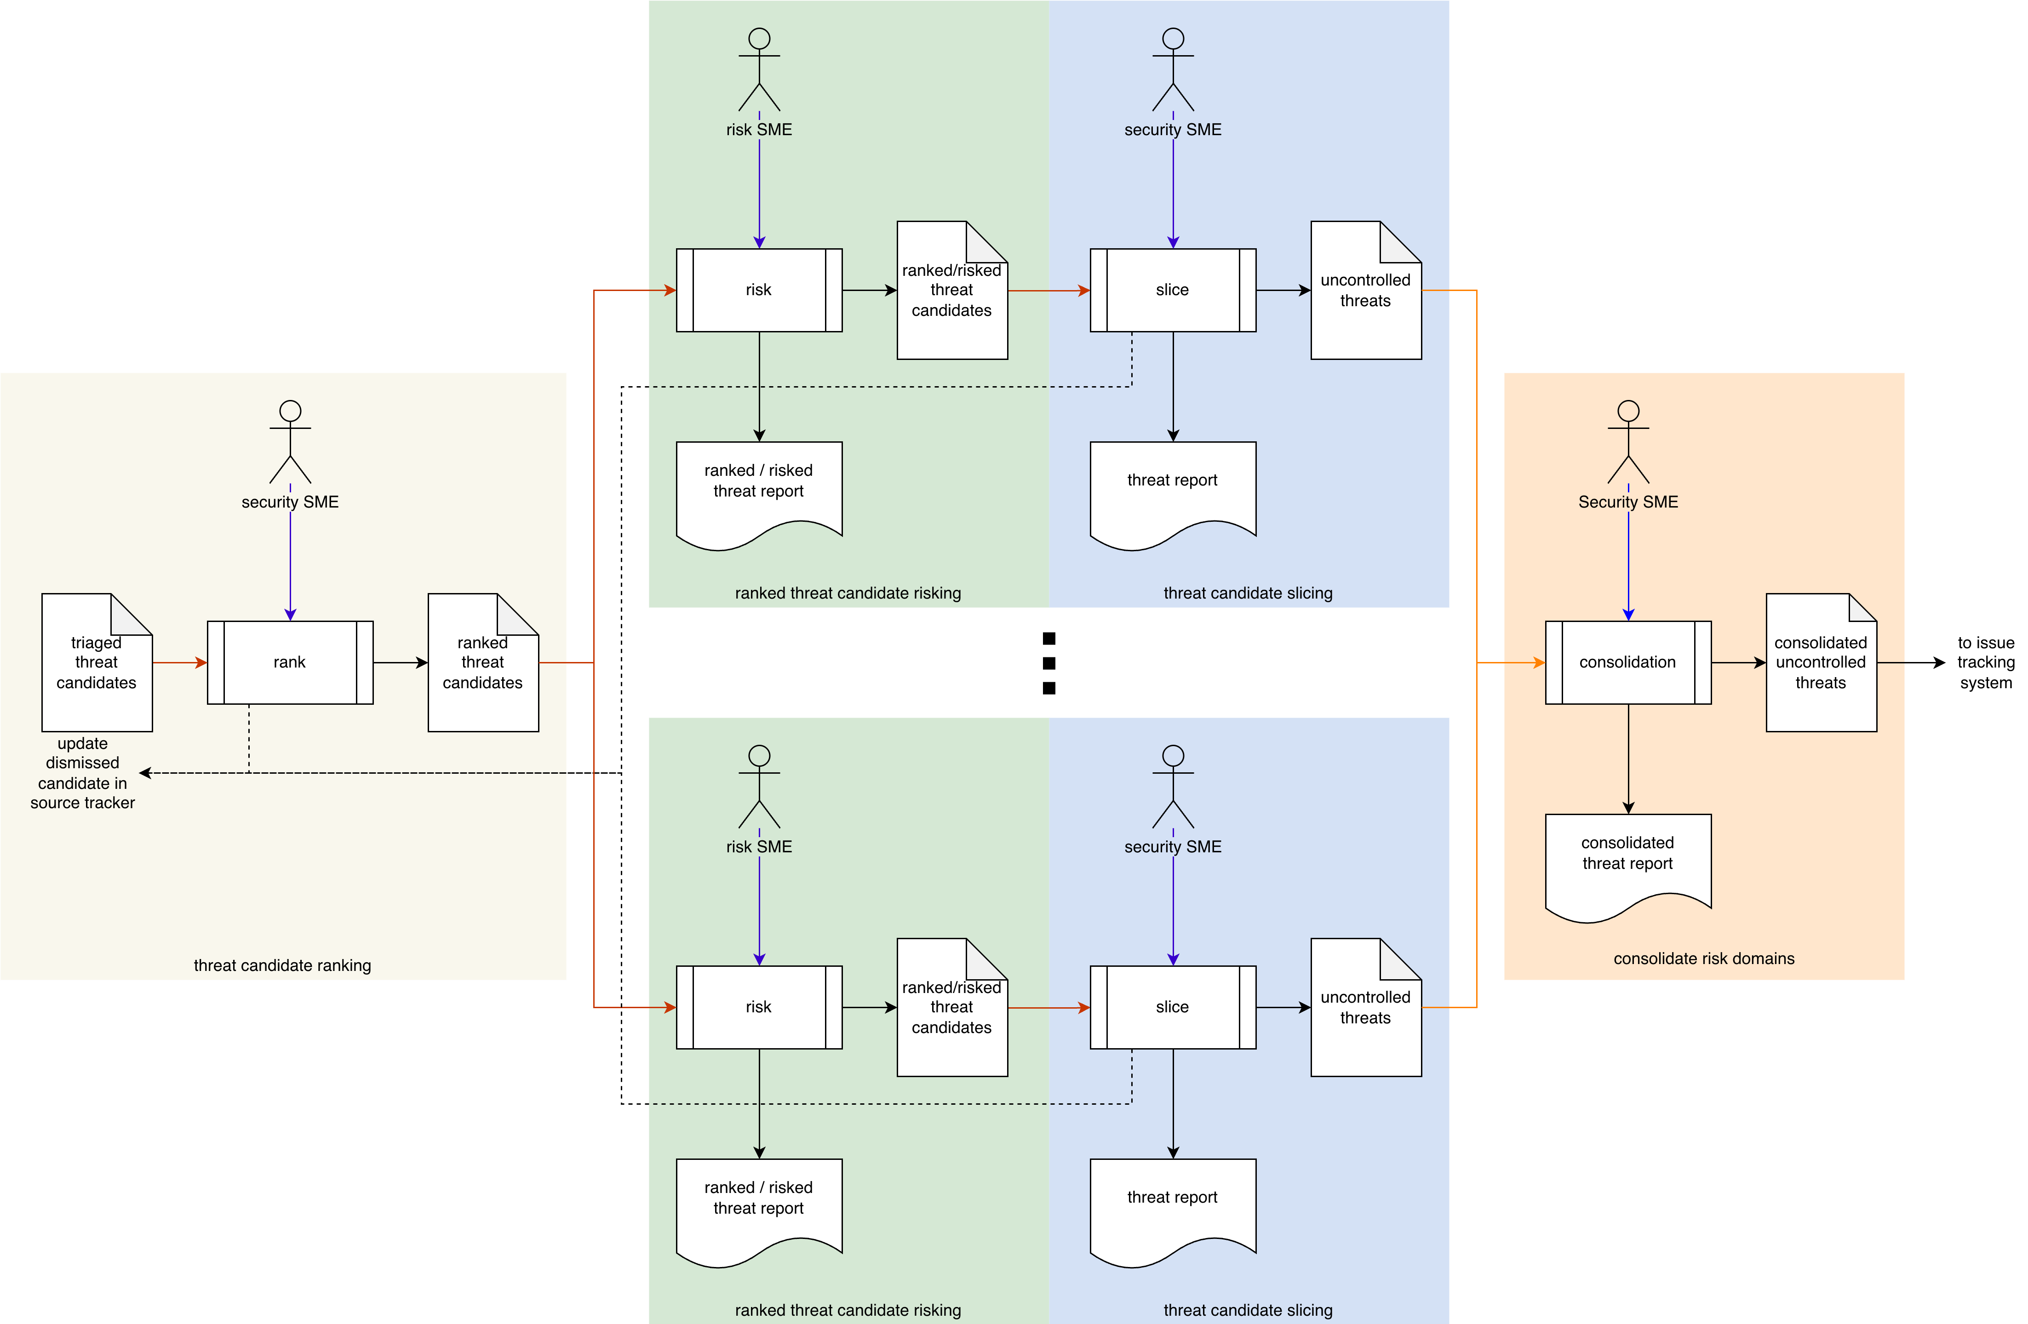
Multi-domain Workflow
Notes:
Script:
If we have multiple risk domains, this poses a problem as the workflow doesn't seem to support this situation.
Keep in mind that each risk domain has its own basis for assigning impact values.
In order to address this, we’ll need to take our ranked threat candidates feeding into the risking and slicing activities.
[break]
And instead apply them on a per domain basis.
This is going to yield
[pause]
a list of uncontrolled threats for each domain.
We'll then need
[pause]
to add an additional activity that will perform a consolidation of all of the uncontrolled threats.
Let's look at that activity.

Slide 25
Multi-domain Workflow
Notes:
Script:
If we have multiple risk domains, this poses a problem as the workflow doesn't seem to support this situation.
Keep in mind that each risk domain has its own basis for assigning impact values.
In order to address this, we’ll need to take our ranked threat candidates feeding into the risking and slicing activities.
[break]
And instead apply them on a per domain basis.
This is going to yield
[pause]
a list of uncontrolled threats for each domain.
We'll then need
[pause]
to add an additional activity that will perform a consolidation of all of the uncontrolled threats.
Let's look at that activity.

Slide 26
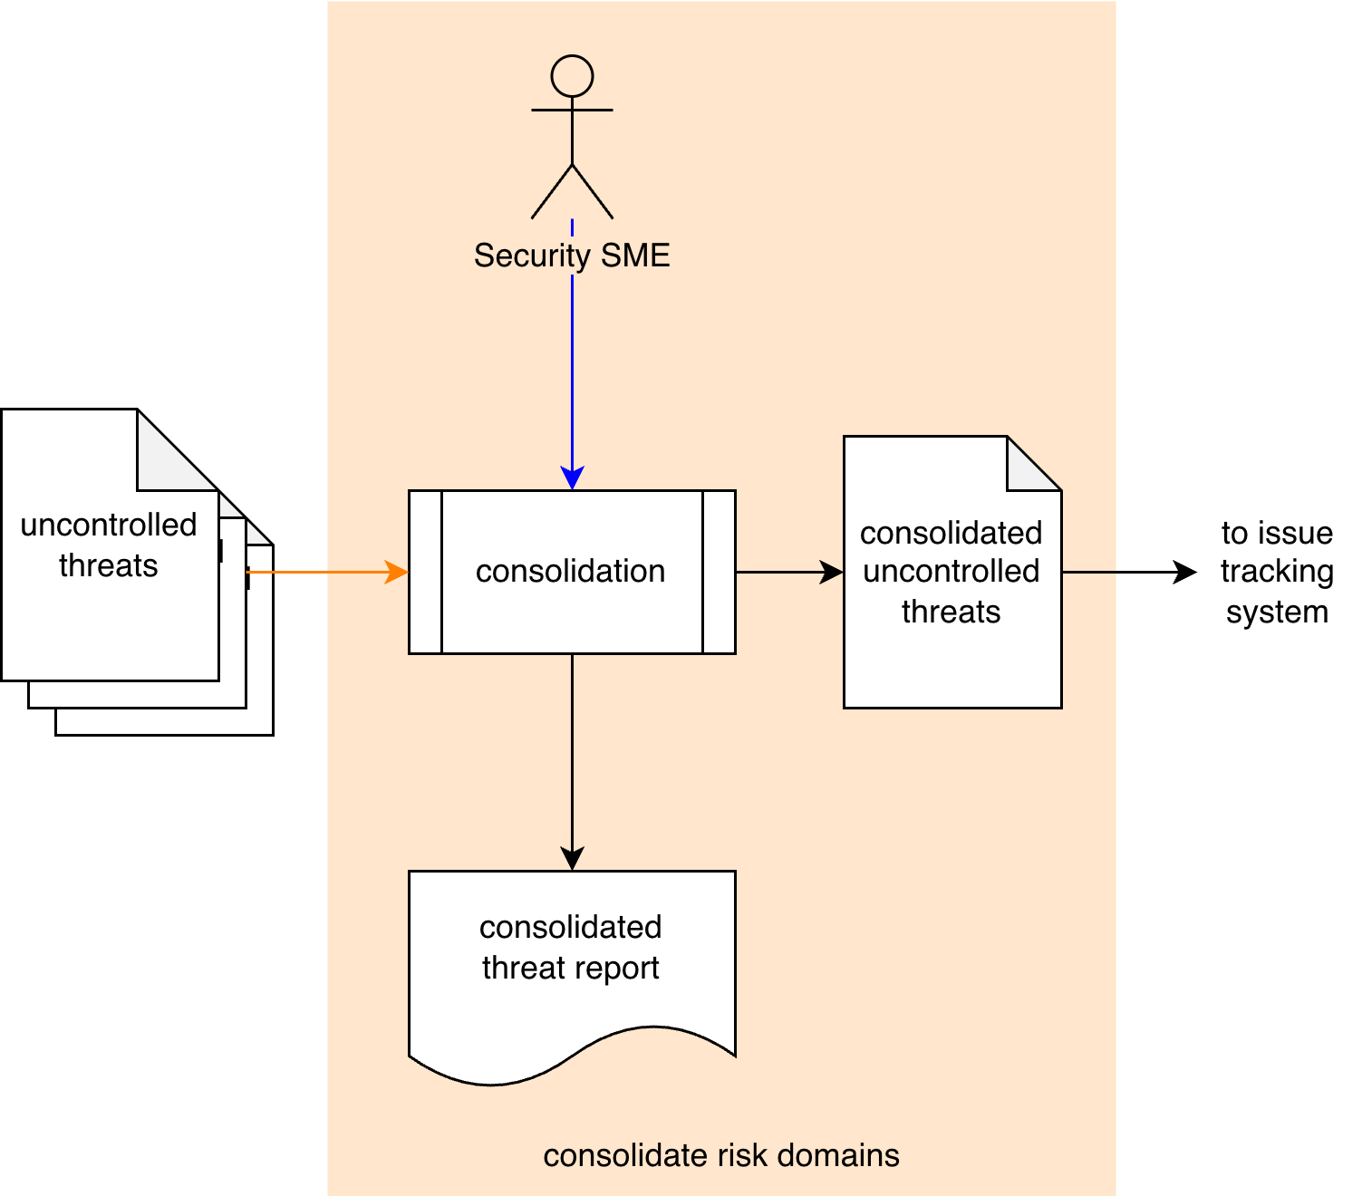
Multiple Risk Domain Consolidation
Consider all risk domains
Preserve traceability
Notes:
Script:
In the consolidation activity,
[pause]
the security SME takes
[pause]
the uncontrolled threats from each of the risk domains under consideration and
[pause]
consolidates them into
[pause]
a consolidated uncontrolled threat list which is then fed into
[pause]
the issue tracking system.
[pause]
Additionally, a consolidated threat report is generated.
Because you are
[pause]
considering all risk domains, you'll have cases where multiple risk domains call out the same threat as uncontrolled.
[pause]
Because of this, it's important to preserve traceability so you can ensure and verify that each of the threats has been treated as appropriate for the risk domain it impacts.

Slide 27
Recap
Notes:
Script:
That covers our overview of the threat prioritization process.
Let's look at a summary.

Slide 28
Summary
Determine the likelihood (rank)
Determine the impact (risk)
Identify uncontrolled threats (slice)
Merge multiple risk domain information (consolidate)
Notes:
Script:
When performing threat prioritization,
[pause]
first determine the likelihood of each threat candidate.
[pause]
Next determine the impact.
[pause]
Third, identify the uncontrolled threats.
And finally,
[pause]
merge any multiple risk domain information.

Slide 29
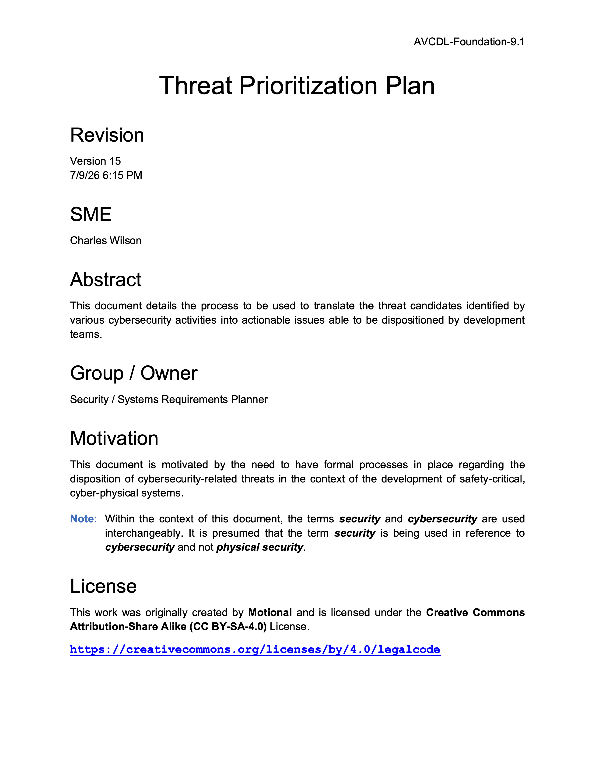
Further Reading
Notes:
Script:
For additional information and to get a more in-depth set of references, the Threat Prioritization Plan secondary document is available in the AVCDL GitHub repository.

Slide 30
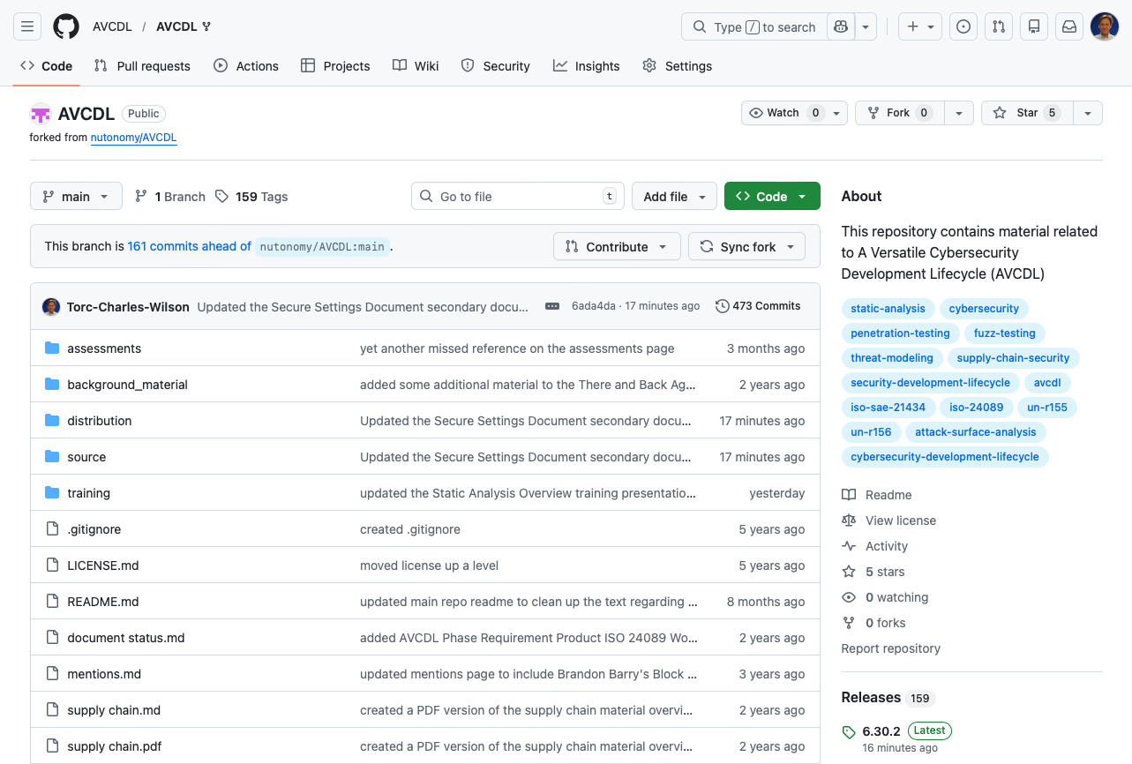
AVCDL on GitHub
https://github.com/AVCDL/AVCDL
Notes:
Script:
All AVCDL materials, both in source and distribution forms, are available on our GitHub site, as shown here.
Because of the size of the repository, it's recommended that you either clone the repository or download a ZIP archive of it, if you're not familiar with using git.
Instructions for downloading a ZIP archive are linked to on the repository’s front page.

Slide 31
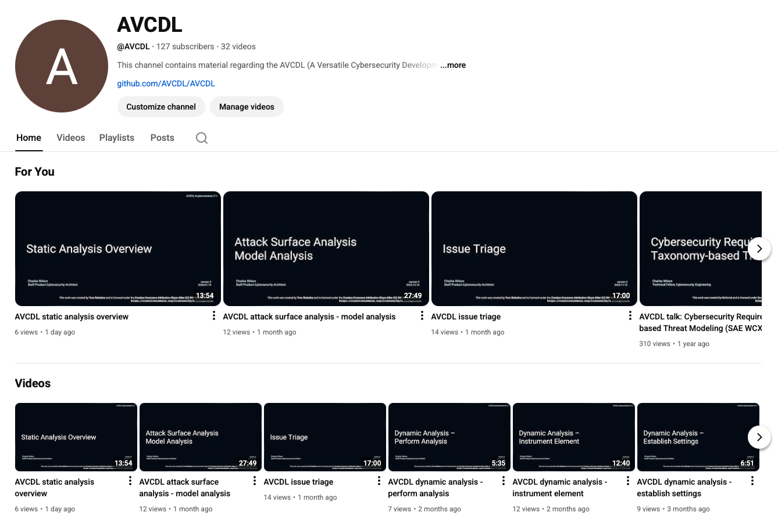
AVCDL on YouTube
https://youtube.com/@AVCDL
Notes:
Script:
Videos covering various aspects of the AVCDL are available on our YouTube channel, as shown here.
It's important to note that all AVCDL materials with the exception of the introductory blog posts are intended for product cybersecurity engineering practitioners.

Slide 32
Next Steps
Notes:
Script:
With this training complete, if you’ve completed the other trainings covering the Threat Prioritization process activities, you can proceed to
Attack surface analysis
Threat modeling
Penetration testing
and
Vulnerability identification
Additionally, if you’ve completed Secure Coding and it’s prerequisites, you can proceed to
Static analysis
Dynamic analysis
Fuzz testing
and
Secure code review

Slide 33
References (1 of 2)
AVCDL (AVCDL primary document)
Incident Response Plan (AVCDL secondary document)
Attack Surface Analysis Report (AVCDL secondary document)
Threat Modeling Report (AVCDL secondary document)
Threat Prioritization Plan (AVCDL secondary document)
Static Analysis Report (AVCDL secondary document)
Dynamic Analysis Report (AVCDL secondary document)
Fuzz Testing Report (AVCDL secondary document)
Penetration Testing Report (AVCDL secondary document)
NIST SP 800-39 - Managing Information Security Risk - Organization, Mission, and Information System View
https://nvlpubs.nist.gov/nistpubs/Legacy/SP/nistspecialpublication800-39.pdf
Notes:
Script:
Here are references to the source material used in the creation of this presentation.
They'll also be included in the video description.
Additionally, this presentation’s source material will be provided on the AVCDL GitHub repository.

Slide 34
References (2 of 2)
NIST SP 800-30 r1 - Guide for Conducting Risk Assessments
https://nvlpubs.nist.gov/nistpubs/Legacy/SP/nistspecialpublication800-30r1.pdf
EVITA D2.3 Security requirements for automotive on-board networks based on dark-side scenarios
https://zenodo.org/record/1188418/files/EVITAD2.3v1.1.pdf
Jeff Masin, a one-man band in New York City [slgckgc, CC BY 2.0]
https://www.flickr.com/photos/slgc/8037345945/
https://commons.wikimedia.org/w/index.php?curid=47370848
Orchestra Simfonica București [Alxndrul - own work, CC BY-SA 4.0]
https://commons.wikimedia.org/w/index.php?curid=47237273
One man band 1865 [Lemur12 - own work, CC BY-SA 3.0]
https://commons.wikimedia.org/w/index.php?curid=5527428
Notes:
Script:
(carry over to fit time)

